Slide 1
Stereoscopic Depth Mapping
Eric Henderson, Nick Kamper, Laura Moss, James Savage
CSSE463 – Image Recognition

Slide 2
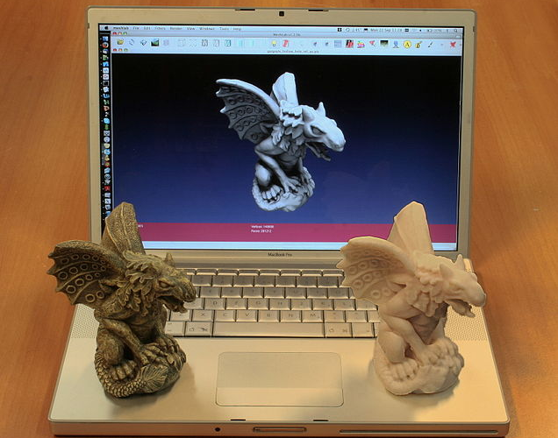
Where’s Depth Mapping Used?
Notes:
3D modelling is a popular application of depth mapping, even more popular with the advent of DIY 3D printers, such as the Reprap

Slide 3
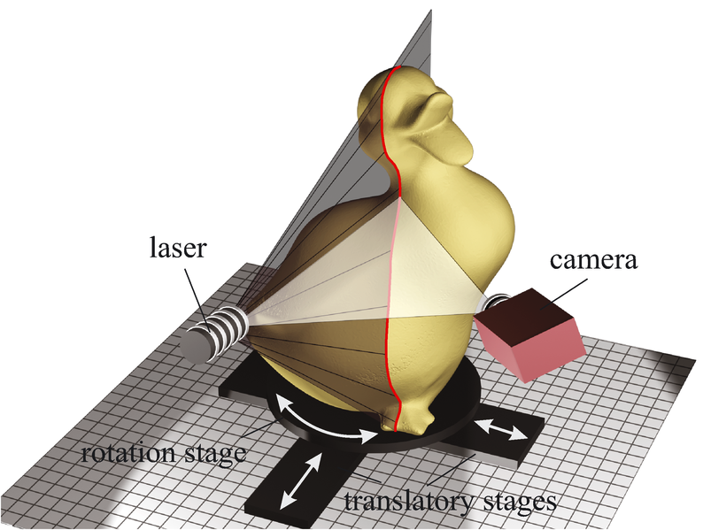
Where’s Depth Mapping Used?
Notes:
“Scanning” a physical 3D object can use an apparatus like such, which spins the object around while shining a laser on it

Slide 4
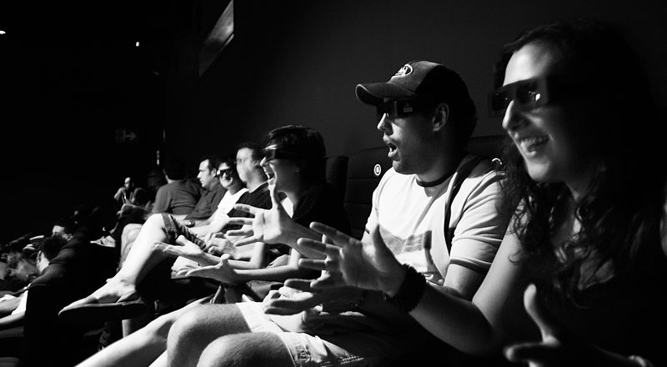
Where’s Depth Mapping Used?
Notes:
3D movies are becoming more and more popular

Slide 5
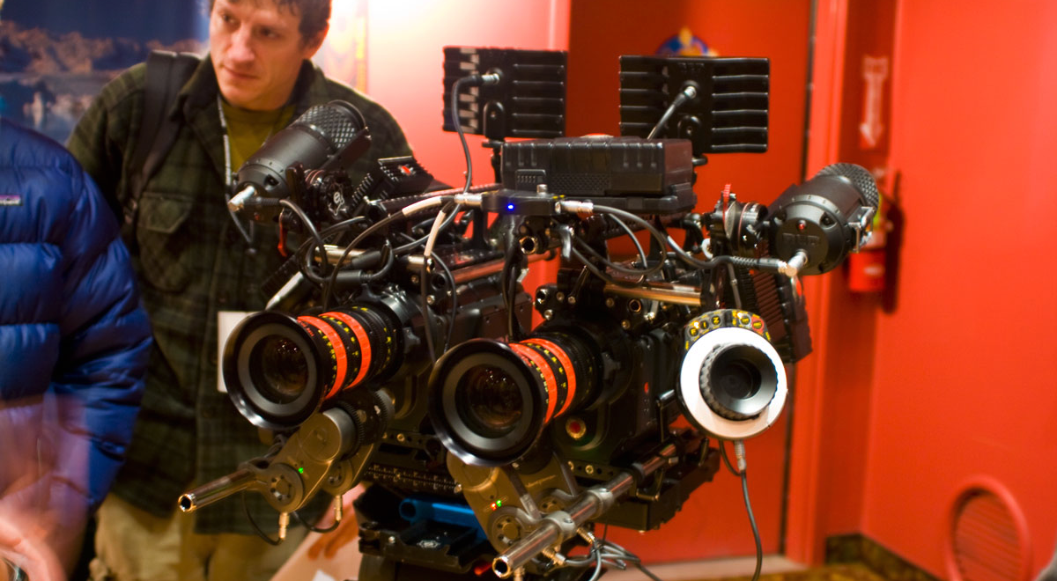
Where’s Depth Mapping Used?
Notes:
The RED 3D camera, used to film several blockbuster 3D films

Slide 6
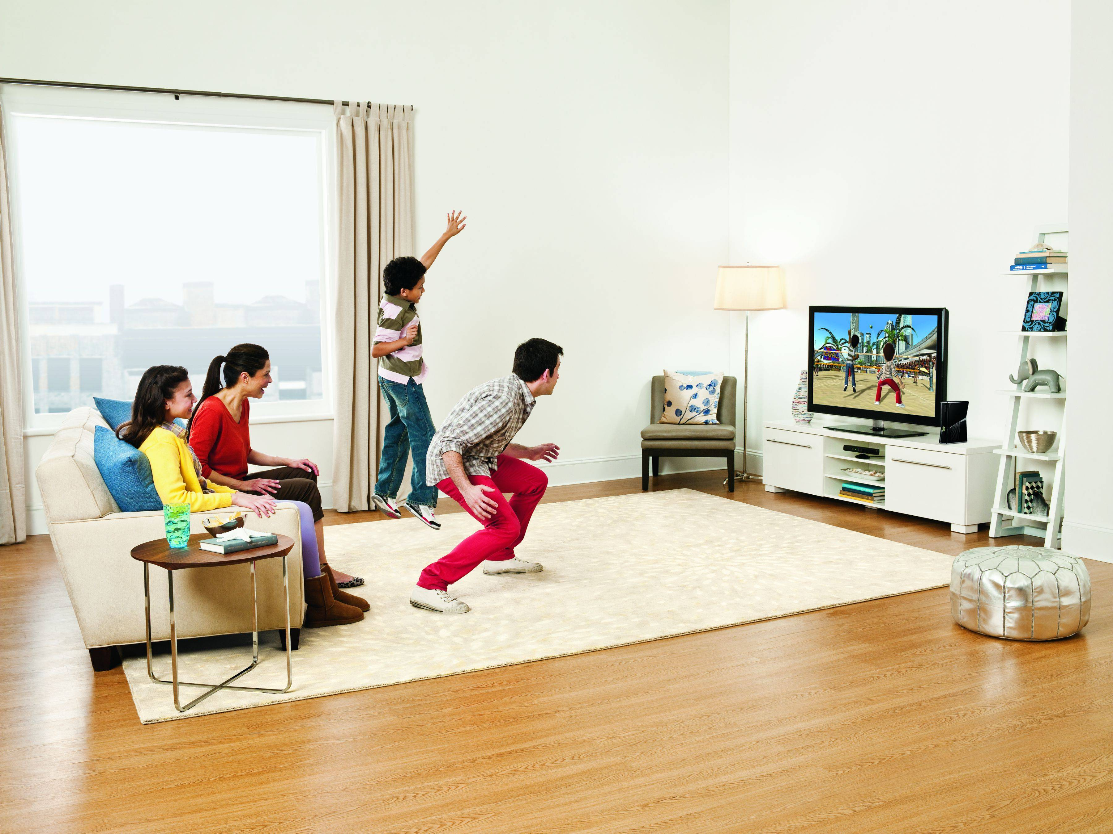
Where’s Depth Mapping Used?
Notes:
Xbox Kinect brings depth mapping to consumer applications to detect gestures and body movements

Slide 7
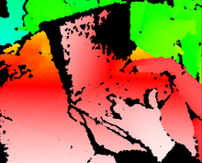
What do these have in common?
Notes:
They all generate depth information!

Slide 8
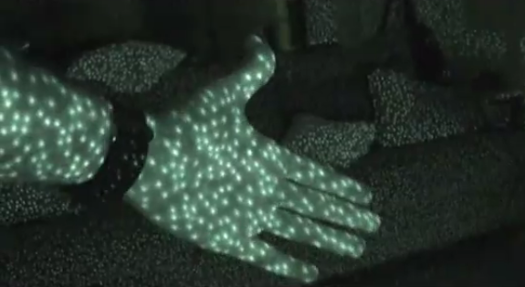
Ways of Implementing Depth Mapping
Notes:
Light-based depth mapping, which shines a laser on a scene and measures how the scene responds to it (such as the size of the laser dots)

Slide 9
Ways of Implementing Depth Mapping
Notes:
Stereoscopic depth mapping, which uses two fixed cameras. Uses distances of corresponding points and information about the cameras (such as the distance and field of view angle) to triangulate the distance of the object from the camera

Slide 10
Ways of Implementing Depth Mapping
Notes:
The RED 3D camera, used to film several blockbuster 3D films

Slide 11
Wait, I thought this was Image Recognition!
Stereoscopic Depth Mapping is a computer vision problem
However, we can apply image recognition techniques to solve a few problems within stereoscopic depth mapping.

Slide 12
Basic Algorithm for Stereoscopic Depth Mapping
Find corresponding points in the stereo images
Using information about the cameras and the distance between the corresponding points, perform some trigonometry to get the distance of that point from the camera

Slide 13
Basic Algorithm for Stereoscopic Depth Mapping
Notes:
Stereoscopic depth mapping, which uses two fixed cameras. Uses distances of corresponding points and information about the cameras (such as the distance and field of view angle) to triangulate the distance of the object from the camera

Slide 14
Other Ways of Matching Points
If we knew the camera’s intrinsic parameters (such as the focal length, principal point, scale, and skew), we could find the epipolar line for a given point
The corresponding point in the other image would lie on the epipolar line in the other image
However, calibrating a camera to get the parameters is messy, so we use a different image recognition-based approach

Slide 15
A Failed Approach to Finding Interesting Points
Directed Variance
Found point clusters rather than points
Often identified single pixels of noise in the image, because of their technically high variance

Slide 16
Our Working Approach to Finding Interesting Points
To find interesting points to correspond, we use the Harris/Stephans corner detection algorithm (available in MATLAB)
Why corners? Because they’re “different” enough that the features should be easy to compare!
The main idea of the Harris/Stephan Corner Detection Algorithm is to find areas with well-defined spikes in output from the X and Y partial derivatives.

Slide 18
Approaches to Matching Points
We then compare features of the interesting points in one image to those in the other image to find a match
Currently, we’re just using template matching using a window surrounding the interesting point and comparing RGB color distance
However, we eventually want to incorporate edges and other features into our feature comparison

Slide 19
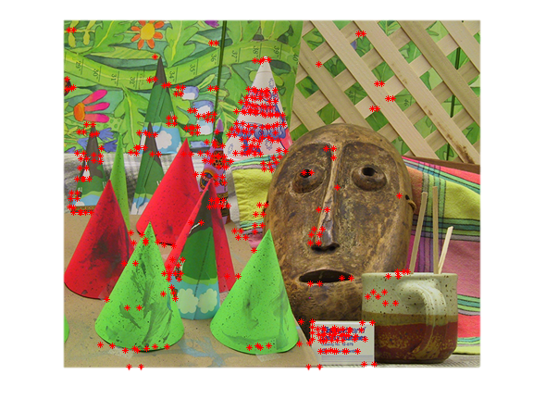
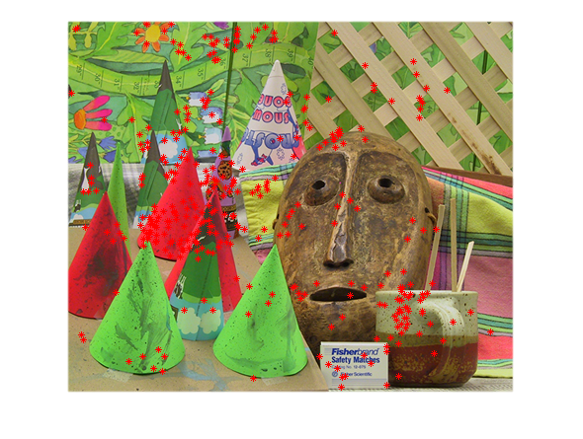
Directed Variance interesting points (left), corresponding points using template matching (right)

Slide 20
Depth Mapping

Slide 21
Lessons Learned
Corresponding points is HARD – and we’re only trying to solve a specific subset!
Corresponding a lot of points is even harder – especially in areas without a lot of texture or variation
MATLAB can be treacherous to optimize

Slide 22
Lessons Learned
Notes:
Use to talk about lack of texture.

Slide 23
Questions? Comments? Concerns? Interesting Anecdotes?

